Slide 1
Trustpilot Causal Impact Analysis
??/11/2022
Presented by: Data Planning @ MG OMD

Slide 2
01
Introduction

Slide 3
02
Methodology

Slide 4
03
Results

Slide 5
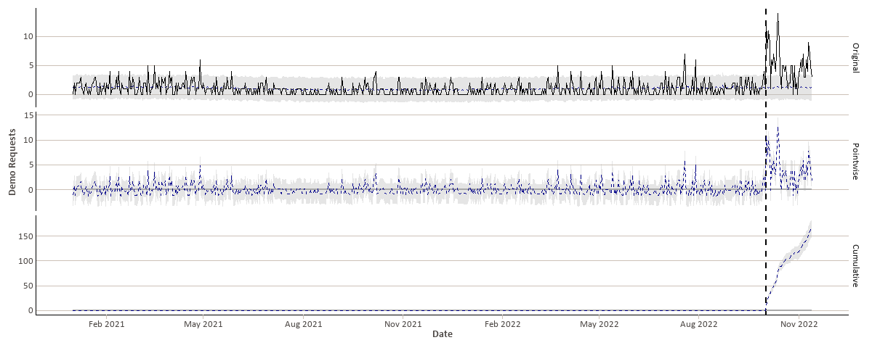
Demo Requests

Slide 6
Results
During the campaign period, in the absence of the campaign, we would have expected an average of 1.2 demo requests per day (with a 95% confidence interval of [0.77, 1.6])
However, during this period, the actual average number of demo requests per day was 5.
We can therefore estimate that the average daily causal effect was 3.9.
Overall, 217 demos were requested during the campaign period.
Of these, we would have expected 51.4 demo requests in the absence of the campaign (with a 95% confidence interval of [33.32, 68.9]).
Therefore, we can estimate the total causal effect of the campaign as 165.6 demo requests.
 | Daily Average | Cumulative
Actual | 5 | 217
Prediction (s.d.) | 1.2 (0.21) | 51.4 (9.04)
95% Confidence Interval | [0.77, 1.6] | [33.32, 68.9]
Absolute Effect (s.d.) | 3.9 (0.21) | 165.6 (9.04)
95% Confidence Interval | [3.4, 4.3] | [148.1, 183.7]
Relative Effect (s.d.) | 322% (18%) | 322% (18%)
95% Confidence Interval | [288%, 357%] | [288%, 357%]

Slide 7
Results
In relative terms, the campaign led to an increase in demo requests of 322%
The probability of these results being explained by a causal effect is 99.90% (conversely, the probability of these results being explained by chance is 0.10%).
Therefore, the causal effect can be interpreted as being statistically significant.
 | Daily Average | Cumulative
Actual | 5 | 217
Prediction (s.d.) | 1.2 (0.21) | 51.4 (9.04)
95% Confidence Interval | [0.77, 1.6] | [33.32, 68.9]
Absolute Effect (s.d.) | 3.9 (0.21) | 165.6 (9.04)
95% Confidence Interval | [3.4, 4.3] | [148.1, 183.7]
Relative Effect (s.d.) | 322% (18%) | 322% (18%)
95% Confidence Interval | [288%, 357%] | [288%, 357%]

Slide 8
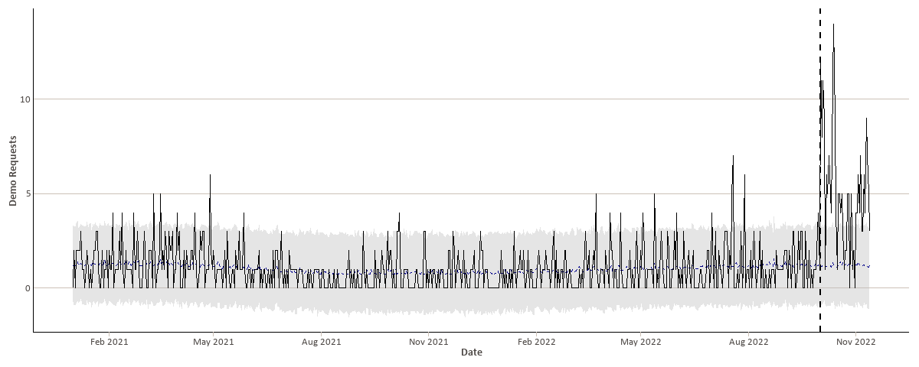
Original Data

Slide 9
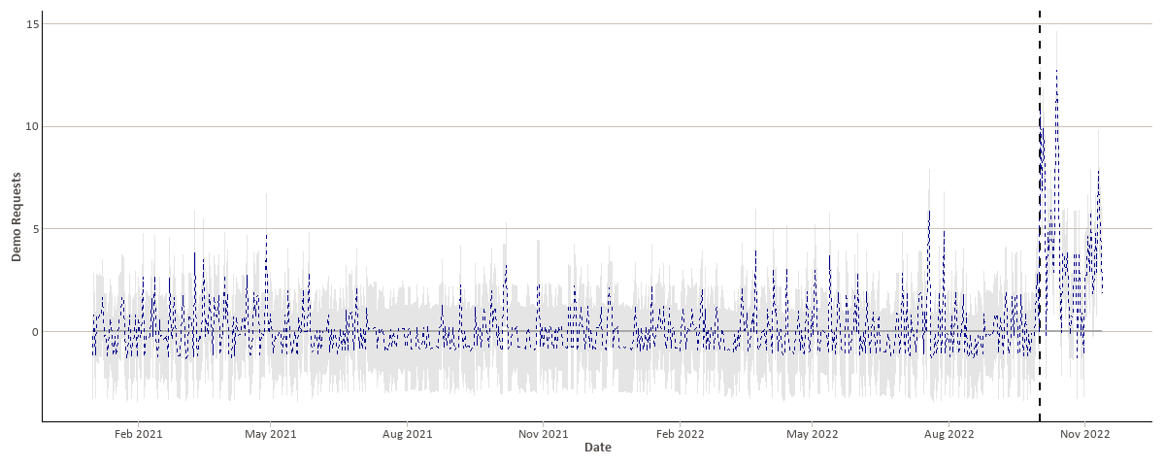
Pointwise Results

Slide 10
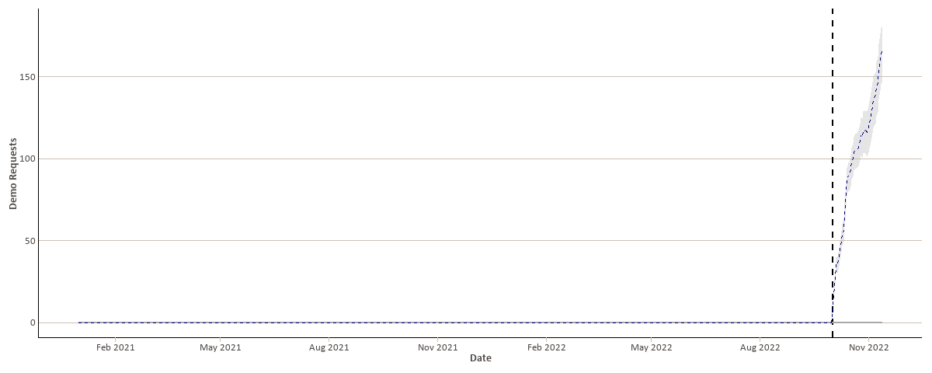
Cumulative Results

Slide 11
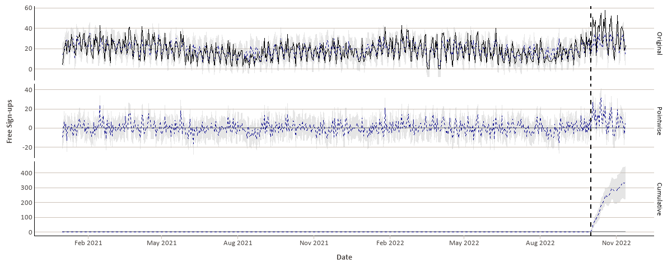
Free sign-ups

Slide 12
Results
During the campaign period, in the absence of the campaign, we would have expected an average of 1.2 demo requests per day (with a 95% confidence interval of [0.77, 1.6])
However, during this period, the actual average number of demo requests per day was 5.
We can therefore estimate that the average daily causal effect was 3.9.
Overall, 217 demos were requested during the campaign period.
Of these, we would have expected 51.4 demo requests in the absence of the campaign (with a 95% confidence interval of [33.32, 68.9]).
Therefore, we can estimate the total causal effect of the campaign as 165.6 demo requests.
 | Daily Average | Cumulative
Actual | 5 | 217
Prediction (s.d.) | 1.2 (0.21) | 51.4 (9.04)
95% Confidence Interval | [0.77, 1.6] | [33.32, 68.9]
Absolute Effect (s.d.) | 3.9 (0.21) | 165.6 (9.04)
95% Confidence Interval | [3.4, 4.3] | [148.1, 183.7]
Relative Effect (s.d.) | 322% (18%) | 322% (18%)
95% Confidence Interval | [288%, 357%] | [288%, 357%]

Slide 13
Results
In relative terms, the campaign led to an increase in demo requests of 322%
The probability of these results being explained by a causal effect is 99.90% (conversely, the probability of these results being explained by chance is 0.10%).
Therefore, the causal effect can be interpreted as being statistically significant.
 | Daily Average | Cumulative
Actual | 5 | 217
Prediction (s.d.) | 1.2 (0.21) | 51.4 (9.04)
95% Confidence Interval | [0.77, 1.6] | [33.32, 68.9]
Absolute Effect (s.d.) | 3.9 (0.21) | 165.6 (9.04)
95% Confidence Interval | [3.4, 4.3] | [148.1, 183.7]
Relative Effect (s.d.) | 322% (18%) | 322% (18%)
95% Confidence Interval | [288%, 357%] | [288%, 357%]

Slide 14
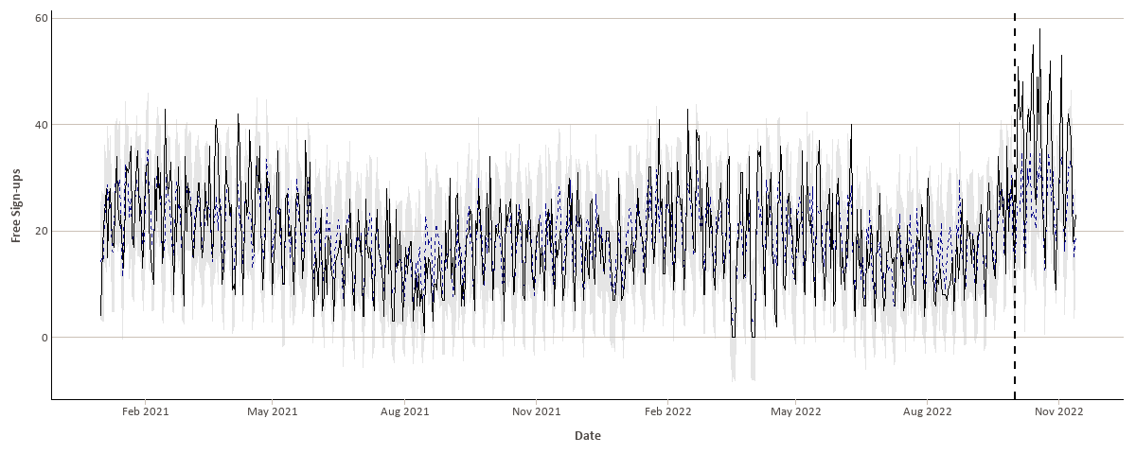
Original Data

Slide 15
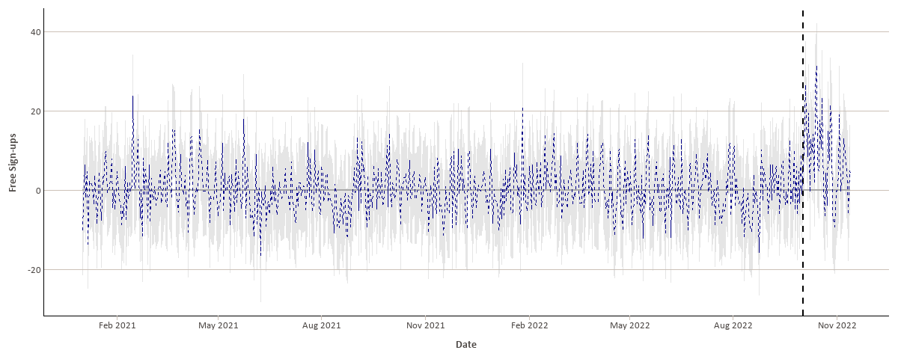
Pointwise Results

Slide 16
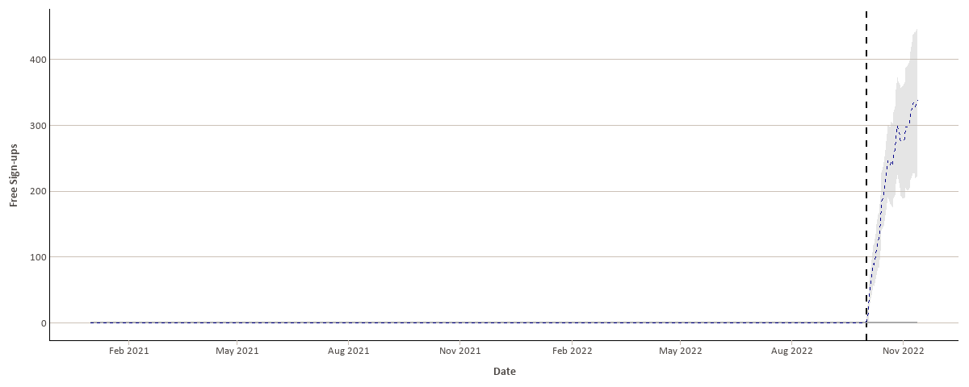
Cumulative Results

Slide 17
04
Conclusion

